Slide 1


HIVE to ICEBERG

Slide 2


Apache Hive
Apache Hive is open-source data warehouse software project built on top of Apache Hadoop to provide data query and analysis capabilities via a SQL-like interface.
Hive supports storage on AWS S3, ADLS, and GCS through the Hadoop Distributed File System (HDFS). With Hive, using SQL, can read, write, and manage petabytes of big data.

Slide 3
Hive Architecture
There are four main components of Apache Hive:
Driver – The component that receives queries
Compiler – The component that parses queries
Metastore – The component that stores all the structure information of the various tables and partitions
Execution Engine – The component that executes the execution plan created by the compiler

Slide 4
Apache Iceberg
Apache Iceberg is an open table format that was designed with modern cloud infrastructure in mind.
It was created at Netflix to overcome the limitations of Apache Hive and includes key features like efficient updates and deletes, snapshot isolation, and partitioning.

Slide 5
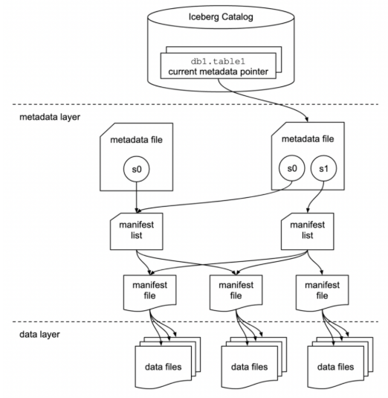
Iceberg Architecture
Apache Iceberg has three layers:
The Iceberg catalog
The metadata layer
The data layer

Slide 6
Data Management and Metadata
Hive Tables: Rely on the Hive Metastore to track table schemas and file locations. Data files are managed by the user, and changes to the underlying files (adding, deleting) require explicit updates in the Metastore or can lead to inconsistencies.
Iceberg Tables: Fully manage their data and metadata. They use a separate metadata layer to track all data files, schema evolution, and historical versions. This provides features like time travel and snapshot isolation.

Slide 7
Concurrency and Transactions
Hive Tables: Not inherently designed for concurrent operations, especially DDL and DML, which can lead to data inconsistencies or failures during concurrent writes. Hive ACID tables offer transactional capabilities but are not universally supported.
Iceberg Tables: Built with ACID transaction support, enabling reliable concurrent DML and DDL operations. This ensures data consistency and integrity even with multiple users or applications modifying the table simultaneously.

Slide 8
Schema Evolution
Hive Tables: Schema changes often require rewriting entire datasets, which can be costly and time-consuming for large tables.
Iceberg Tables: Support robust schema evolution (adding, dropping, reordering columns) without requiring data rewrites, making schema updates more efficient.

Slide 9
Partitioning
Hive Tables: Use explicit, folder-based partitioning, where partitions are physical directories in the file system. Adding or changing partitions can be cumbersome.
Iceberg Tables: Employ metadata-driven hidden partitioning, which allows for more flexible and efficient partitioning schemes without exposing the physical layout to users.

Slide 10
Performance
Hive Tables: Can suffer performance degradation with large numbers of partitions and files due to the need for file system listings and Metastore lookups.
Iceberg Tables: Optimize query performance by avoiding full file system listings and leveraging metadata to efficiently locate relevant data files.

Slide 11
DML Operations (Updates/Deletes)
Hive Tables: Updates and deletes often involve rewriting entire files or partitions, which can be inefficient.
Iceberg Tables: Provide more efficient DML operations through features like copy-on-write and merge-on-read, allowing for granular updates and deletes without extensive data rewrites.

Slide 12
Differences in nutshell
 | HIVE Tables | ICEBERG Tables
Open source | Yes | Yes
Read object storage using SQL | Yes | Yes
File format | Parquet, Orc, Avro | Parquet, Orc, Avro
Performant at scale | Yes | Yes
ACID transactions | No | Yes
Table versioning | No | Yes
Time travel | No | Yes
Schema evolution | No | Yes
Partition evolution | No | Yes
Partition pruning | Yes | Yes

Slide 13
DEMO ICEBERG CAPABILITIES

Slide 14
DEMO MIGRATION HIVE to ICEBERG

